Slide 1


DAF CGOC
Title

Slide 2
Overview
X
X
X

Slide 3
X
Highlighted Point
X

Slide 4
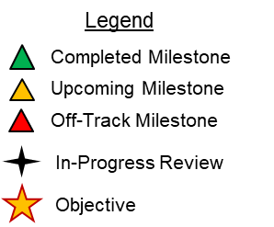
POAM Format
Goal: Establish recurring three-day professional development course for first term company grade officers.
Professional development
Networking
Confident new officers
“Tools for the toolbox”
Current Status:
Hotwash/feedback review
Preparing for future sessions on a biannual basis
Working on registration on Wing In-processing checklist
Potential Issues:
Class size: commanders (specifically operators) sending their people
Continuity of facilitating course
Required Assistance/Resources:
Commanders’ endorsement
~ 2023: FTOC recurring biannual or quarterly classes
6 Jul 22: Course hotwash/feedback review
27-29 Jun 22: FTOC Pilot course
16 Jun 22: Student welcome email; run through of course at venue
9 Jun 22: Student handbook final review/ instructor check-in
2 Jun 22: Student handbook/ curriculum material review
31 May 22: Reservation of Officers closeout; instructor material due
26 May 22: Student handbook draft review
25 May 22: MXG/CC & OG/CC Buy in Brief
19 May 22: Course surveys; FTOC led sessions Force support/ Officer Pyramid/ Team Dyess
17 May 22: DCAB/DCAT Brief (Force Development Flight Chief)
12 May 22: Reservation email to Wing UPCs/First Sergeants; FTOC led session-Key AFIs regulations
4 May 22: MSG/CC Buy in Brief
25 Apr 22: MDG/CC Buy in Brief
14 Apr 22: Student handbook discussion
7 Apr 22: Matching primary/alternate instructors to courses
24 Mar 22: Book venue/begin soliciting instructors
17 Mar 22: Finalize curriculum
10 Mar 22: Venue/course dates/curriculum discussion
22 Feb 22: FTOC Working Group final selection (4 member team)
Sep 25: Initial Curriculum/Goals discussion with CAA
CAO: 6 July 22

Slide 5
Closing Thoughts
Questions?

